Slide 1
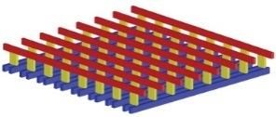
ECE191: Group D Pressure Sensor for Mobile
Mentor: Professor Truong Nguyen, Siarhei Vishniakou
Linh Dinh, Francis Tsui, Anish Bhayani, Joseph Lee
Sponsors:

Slide 2
Agenda
Gantt Chart
Week’s Accomplishments
Sensing Pressure
Simulating Sensor Data
Matlab Processed Data
Summary
Next Week’s Goals

Slide 3
Gantt Chart
Notes:
Talk about the updates: updating stage 3, changing priorities, see technology overview.

Slide 4
Week’s Accomplishments
Understanding framework of project
Arduino: Stage 1
Arduino: Stage 2
MATLAB processing
Bluetooth Research

Slide 5
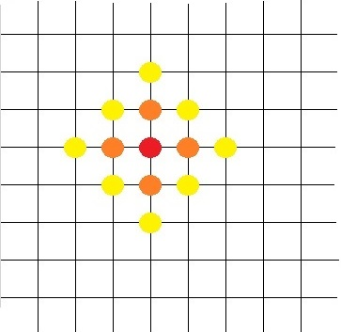
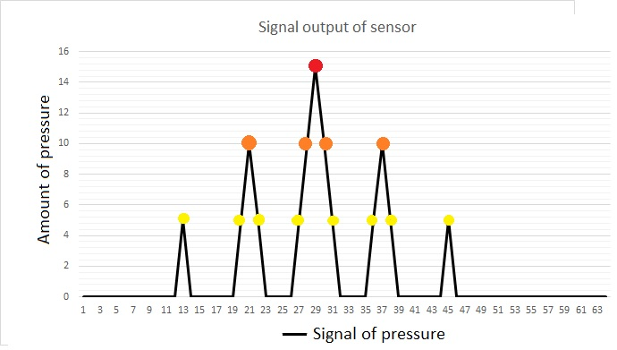
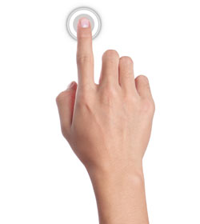
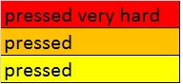
Sensing Pressure - Sampling
Mildly
Divide pulse of voltage into 64 discrete data points

Slide 6
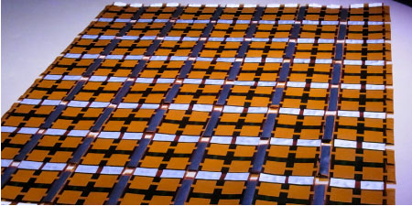
Sensing Pressure - Transmission
Apply pressure on sensor array
Pressure sensor translate pressure into pulse of analog voltage

Slide 7
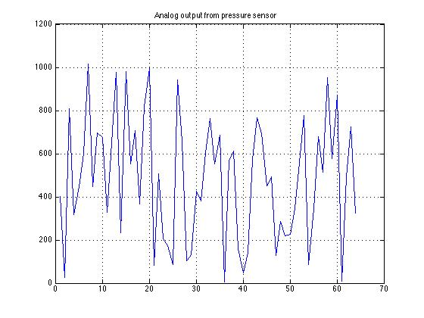
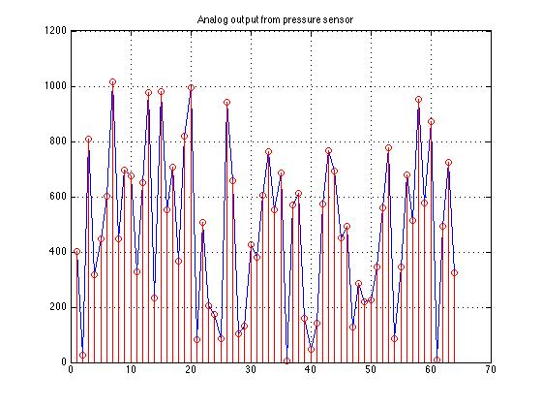
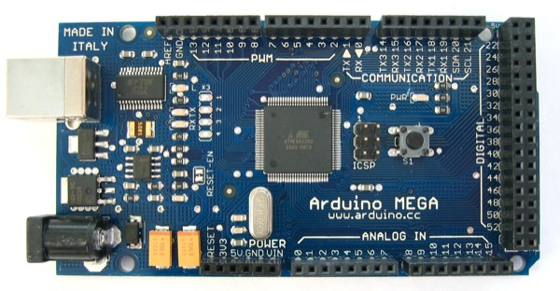
Sensing Pressure - Interfacing
Arduino read the analog input voltage

Slide 8
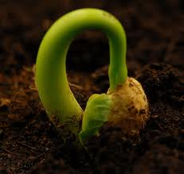
Simulating Sensor Data
From above approach, we would like to simulate the sequence of discrete data points by generating a random number sequence.
Sequence of random numbers
Seed a random number into Arduino
Why seed a random number into Arduino?
Program create pseudo random numbers. Random generator generates will use the seed value to find next number.
If we initially don’t seed a random number into Arduino, it will always generate a same sequence.
This random sequence will simulate the analog output voltage from the pressure sensor (ranging 0-1023) .

Slide 9
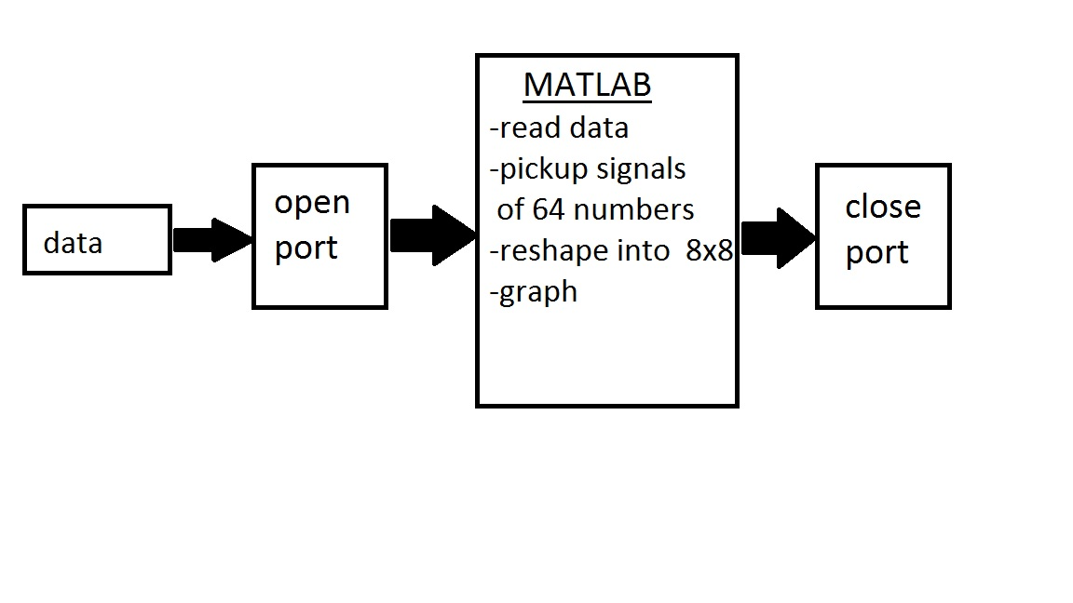
MATLAB Processed Data
Difficulties:
We were unable to process the data in real time.
Process discrete pack of data at a time

Slide 10
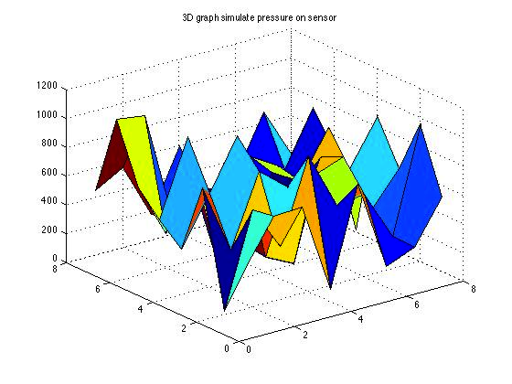
Summary
Understood pressure sensor interface
Generated random data and sent to Matlab
Used Matlab surf() command
3D graph represents pressure at specific points on surface of the sensor
Shows how mobile OS will recognize pressure inputs
Area vs. Area vs. Pressure on Pressure Sensor

Slide 11
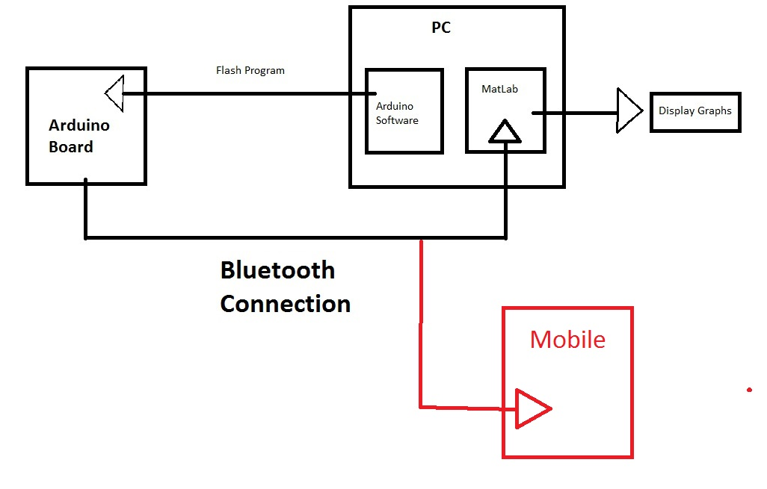
Next Week’s Goals
Bluetooth
One team viewing serial connection between Arduino and PC
One team developing connection to Android phone
Github
Setup server side repository
Client installation on every team member
Notes:
See Francis: please add branch Bluetooth connection to phone.

Slide 12
Thank you
Q&A session

